Slide 1


Sleep Disorder Detection Using Deep Learning and Genetic Algorithm Optimization paper Id :298
Sarath Chandra Beesabattuni
Department of Computer Science and Engineering
Narasaraopeta Engineering College (Autonomous)
Suresh Munnangi
Sai Manikanta Konakanchi
Yamini Chandana
Charles Babu Gundepall
Meeniga Vijaya Lakshm
K.V. Narasimha Reddy

Slide 2
Introduction
Sleep disorders such as Insomnia and Sleep Apnea significantly affect:
Cognitive performance
Physical health
Productivity and quality of life
Millions of people remain undiagnosed due to:
Limited sleep labs
High diagnostic cost
Time-consuming manual analysis

Slide 3
Role of AI in Sleep Disorder Detection
Traditional diagnosis (Polysomnography):
Manual
Expensive
Requires experts
Machine Learning & Deep Learning provide:
Automated diagnosis
Faster decision-making
Scalable healthcare solutions
Enables remote monitoring and AI-based healthcare systems

Slide 4
Background
Existing Approaches
Previous research used:
EEG, ECG, PSG signals
Manual feature extraction
Limitations:
Requires special hardware
Not suitable for large-scale deployment

Slide 5
Dataset-Based Analysis
Recent studies explore:
Lifestyle-based datasets
Physiological parameters
Advantages:
Easily available data
Suitable for wearable devices
Need for optimized deep learning models

Slide 6
Motivation
To reduce dependency on manual diagnosis
To design an accurate and automated system
To improve prediction using:
Deep Learning
Genetic Algorithm Optimization
To support:
  Telemedicine
  Wearable healthcare devices
  Real-time sleep monitoring

Slide 7
Proposed Methodology
Methodology Overview
Data Collection
Data Preprocessing
Model Development
GA Optimization
Model Evaluation
Model Architecture
Implemented Models:
Artificial Neural Network (ANN)
Random Forest
XGBoost
Optimization:
Genetic Algorithm for hyperparameter tuning

Slide 8
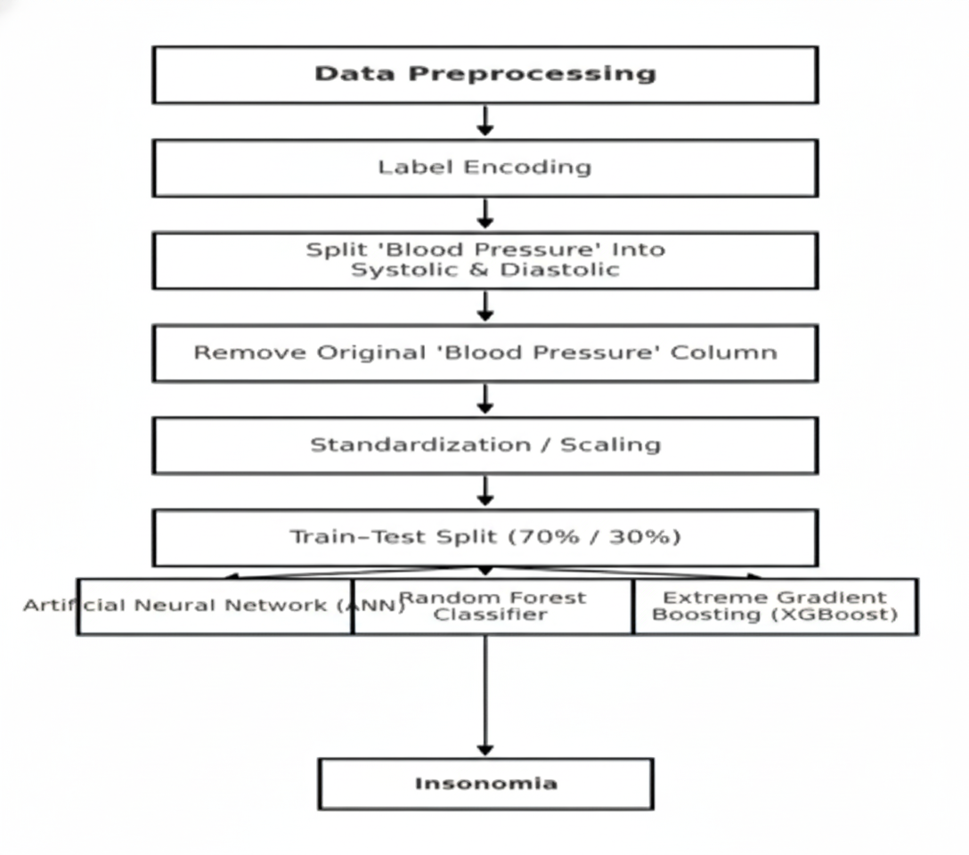

Slide 9
Datasets
Sleep Health and Lifestyle Dataset (Kaggle)
Total Records: 400
Attributes: 13
Key Features:
Age, Gender, Occupation
Sleep Duration, Quality of Sleep
Stress Level, Physical Activity
BMI Category
Blood Pressure (Systolic & Diastolic)
Heart Rate, Daily Steps
Target Classes:
No Disorder
Insomnia
Sleep Apnea

Slide 10
Results and Analysis
Performance Comparison
Model | Accuracy (%)
ANN | 94.17
Random Forest | 91.67
XGBoost | 92.50
ANN achieved the highest accuracy
Balanced precision and recall
Minimal class bias

Slide 11
Training Analysis
Accuracy curve:
Stable increase
No overfitting
Loss curve:
Smooth convergence
GPU (T4) significantly reduced training time
GA improved model generalization

Slide 12
Conclusion
ANN outperformed traditional ML models
GA optimization enhanced accuracy and stability
System proves effective for:
Automated sleep disorder detection
AI-driven healthcare solutions
Suitable for real-time deployment

Slide 13
References
Key References
Zan & Yildiz – FullSleepNet, 2024
Mohammadi et al. – SleepLiteCNN, 2025
Papillon et al. – Vision Transformers for Sleep, 2025
Monowar et al. – Ensemble Learning, 2024

Slide 14
Tools & Dataset
Kaggle: Sleep Health and Lifestyle Dataset
Scikit-learn
Keras & TensorFlow
XGBoost Framework

Slide 15


